Slide 1


WELCOME TO

Slide 2
DATA LITERACY WITH TABLEAU
PROJECT TITLE:
ANALYSING HOUSING PRICES IN METROPOLITAN AREAS OF INDIA.

Slide 3
TEAM PROFILE:
NM TEAM ID : NM2023TMID15820
TEAM LEADER-
POORNIMADEVI.B - (NM ID:590383EC78C1F64BB234D6F2E2BEACE3)
TEAM MEMBERS-
MADHUMITHA.V - (NM ID:246054A3A5166B389CF4E96ED5D32F73)
NITHISHA.G -(NM ID:4660F0E64A280C6A9434F23CC33B7EB2)
ANUSUYA.V - (NM ID:302C8B0B64866C8887C4594B2011A6D2)

Slide 4

UNDER THE GUIDANCE OF
Mr.S.SATHISH, M.Sc.,M.Phil.,
GUEST LECTURER
PG&Research Department of Mathematics
Government Thirumagal Mills collage
Gudiyatham-632602

Slide 5
INTRODUCTION
1.OVER VIEW
House price prediction in a metropolitan city in India is a valuable solution for potential home buyers ,real estate agents, and in investors .
By leveraging historical sales data ,property details, and location –specific information ,a predictive modal can accurately estimate house prices, The modal’s Scalability, real-time updates, user –friendly interface, and transparency ensure it meets the needs of stakeholders. Integration capability , data privacy ,and cost –effectiveness are also important considerations.By addressing these requirements, the prediction modal provides reliable insights, empowering stakeholders to make informed decisions in the fast-paced real estate market.

Slide 6
2.PURPOSE
The goal is to provide a reliable and accurate prediction tool that assists users in navigating the competitive real estate market and maximizing their returns.
The modal should identify the key features impacting house prices and provide insights to aid decision-making.

Slide 7
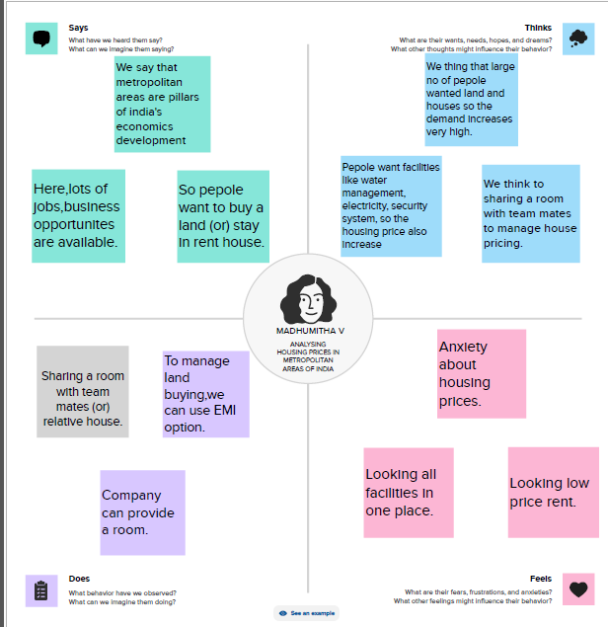
PROBLAM DEFINING & DESING THINKING

Slide 8
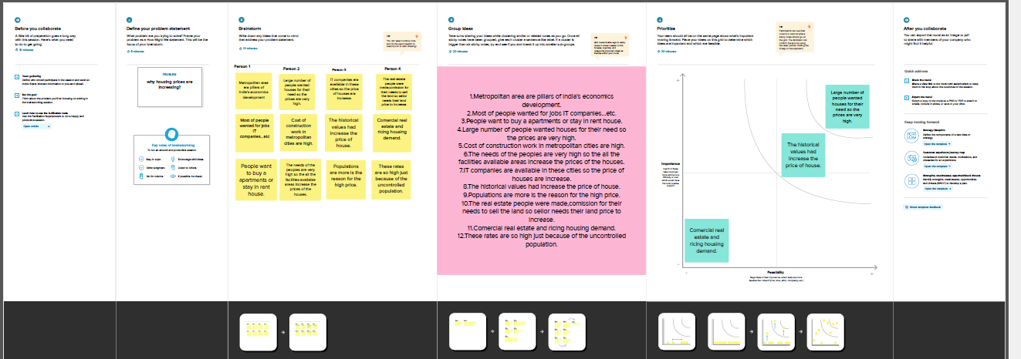
BRAIN STORMING MAP

Slide 9
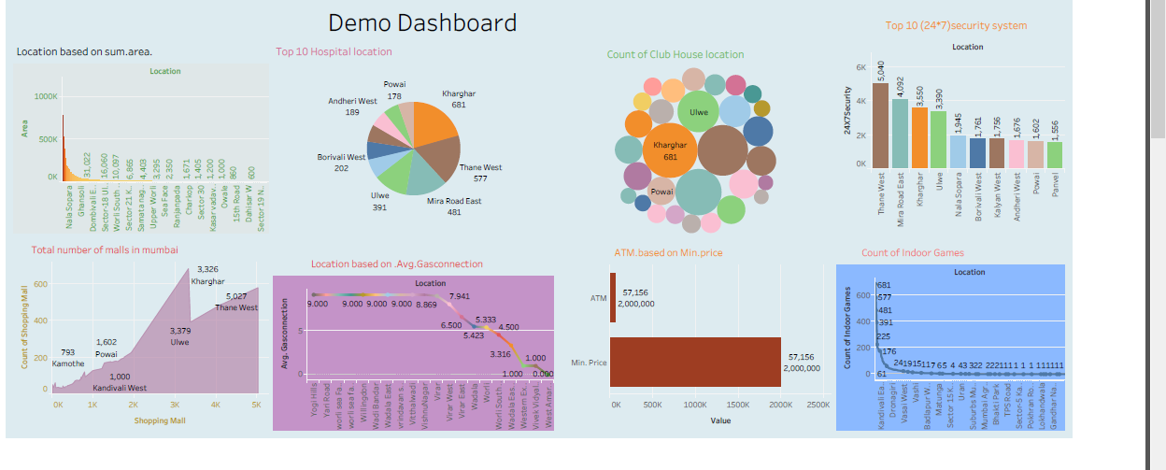
RESULT
DASHBOARD

Slide 10
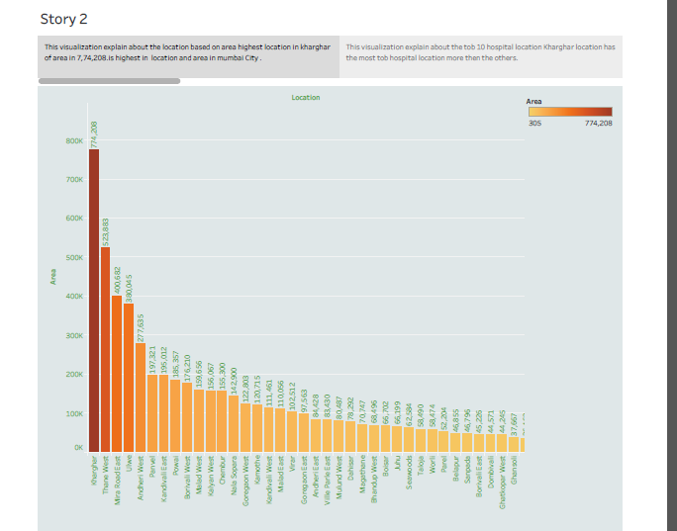
STORY

Slide 11
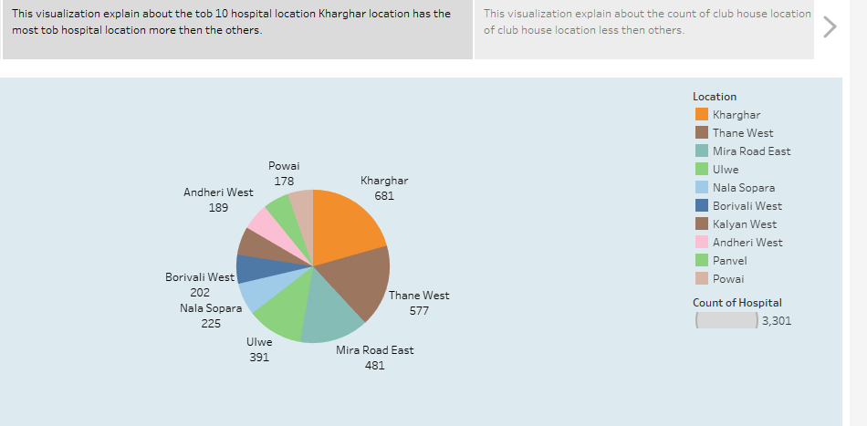
Visualization 2:

Slide 12
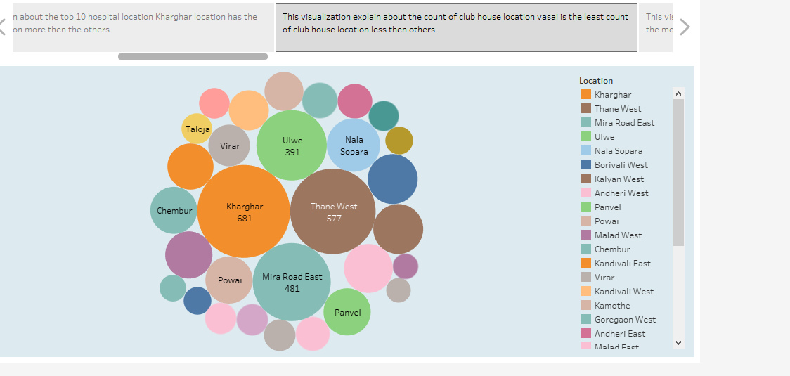
Visualization 3:

Slide 13
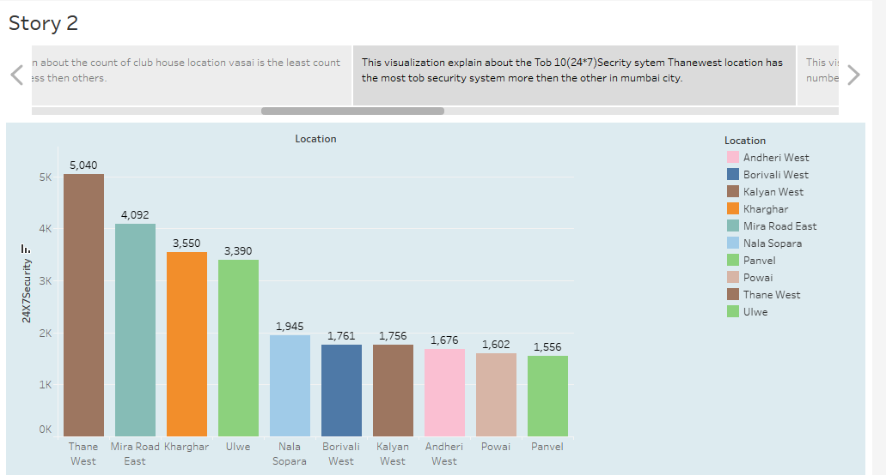
Visualization 4:

Slide 14
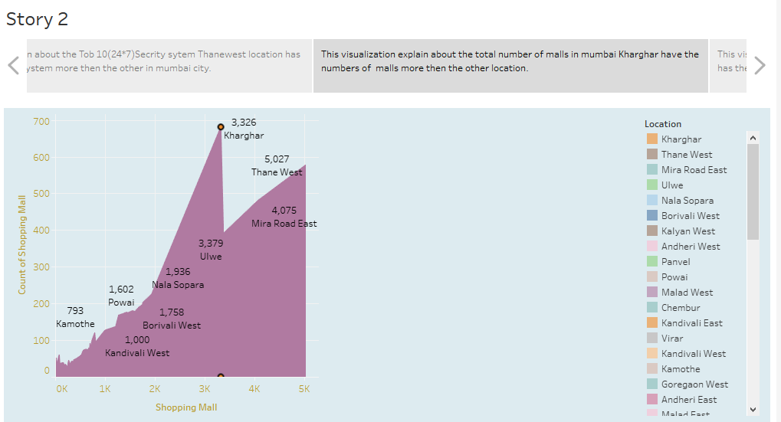
Visualization 5:

Slide 15
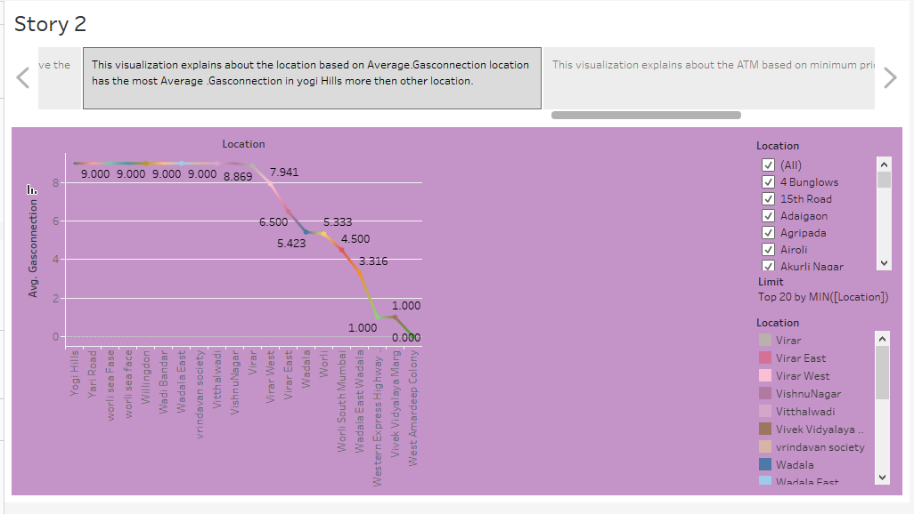
Visualization 6:

Slide 16
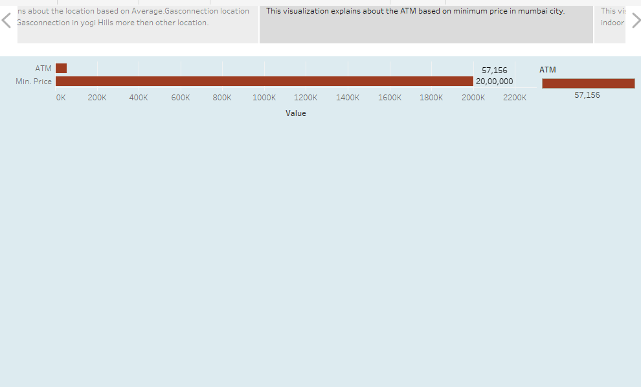
Visualization 7:

Slide 17
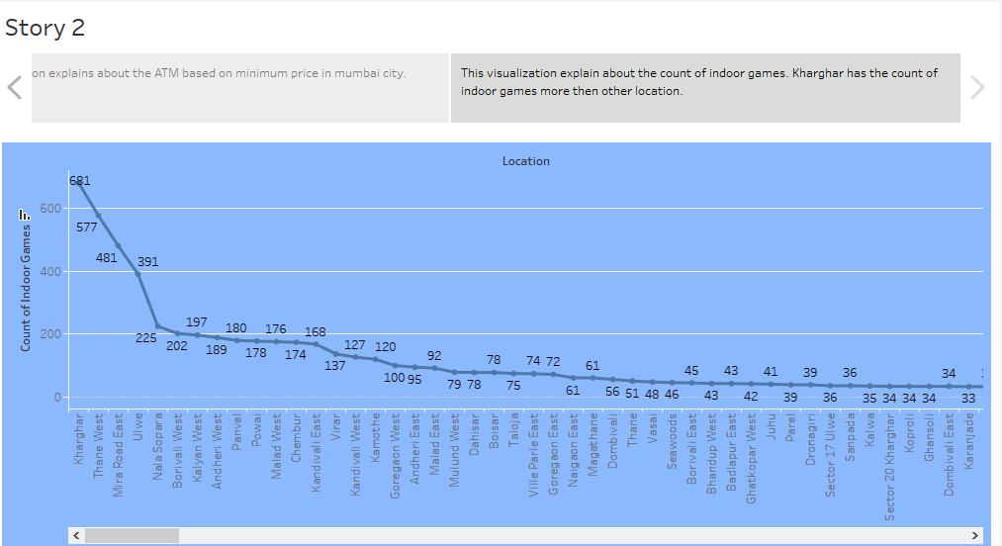
Visualization 8:

Slide 18
DASHBOARD LINK:
public.tableau.com/app/profile/madhumitha.v5905/viz/sheet1_16962472390730/Dashboard3
STORY LINK:
public.tableau.com/app/profile/madhumitha.v5905/viz/AnalysisofHousingpriceinmetroareaofIndia/Story2

Slide 19
CONCLUSION:
Generally, see a overall, We See a .
1.Intro of this the Data literacy with tableau:
Analysing housing prices in metropolitan areas of india .
2.Problem Definition & Design Thinking.
3.Result.
4.Dashboard link.
5.Story link.

Slide 20
THANK YOU

